Slide 1
WISE Midsemester Design Review Fall 2014
SLHS-VID
SLAC
Dining Services
EPICS Explorer

Slide 2
SLHS-VID
Jimmy Dixon
Matthew Pace
Ze An
Notes:
Introductions: Name, major, role. Jimmy will go last to transition to next slide.

Slide 3
PROJECT PARTNER
Department of Speech Language and Hearing Sciences (SLHS)
Contacts
Anu Subramanian
Clinical Associate Professor
Barbara Cicholski
Clinical Assistant Professor
Notes:
Jimmy

Slide 4
PROJECT OBJECTIVES
To design a web application to allow students of SLHS to practice administering speech therapy examinations
Support a variety of subjects and examinations
Provide dynamic feedback on the student’s administration of the exam, based on their choices
Notes:
Matt

Slide 5
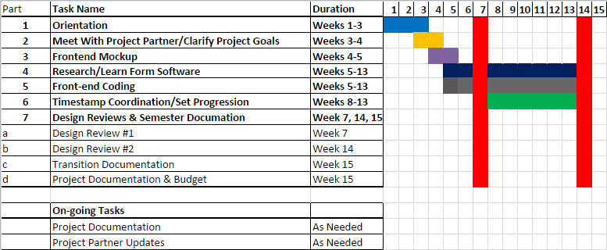
SEMESTER TIMELINE
Notes:
Ze: Talk about each part (to increase presentation time)

Slide 6
THIS SEMESTER
Initial meeting with Project Partners
Obtained a clear picture of partner’s needs
Clarified the scope of the project and team abilities
Developed mock-up and framework for website
Received approval of mock-up
Developed a prototype website with basic functionality
Video selection
Form slideout
Notes:
Ze: Mention that this project is new this semester, and that there is no budget

Slide 7
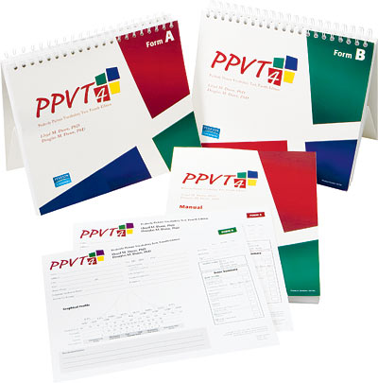
EXAMINATION BEING IMPLEMENTED
http://pearsonassess.ca/haiweb/Cultures/en-CA/Products/Product+Detail.htm?CS_ProductID=PPVT-4&CS_Category=educational-basic-skills&CS_Catalog=TPC-CACatalog
Notes:
Jimmy
The test is given verbally and takes from twenty to thirty minutes to complete. No reading is required by the individual, and scoring is rapid. For its administration, the examiner presents a series of pictures to each person. There are four pictures to a page, and each is numbered. The examiner speaks a word describing one of the pictures and asks the individual to point to or say the number of the picture that the word describes. Item responses can also be made by multiple choice selection depending on the age of the person being tested. The total score can be converted to a percentile rank, mental age, or a standard deviation IQ score. Although desirable, no special training is required to properly administer and score the PPVT-IV. The test publisher recommends that anyone interpreting or explaining the test scores should have knowledge in psychological testing and statistics.

Slide 8
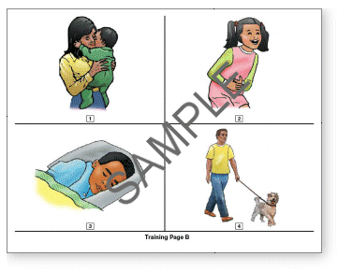
http://images.pearsonclinical.com/images/pa/ppvt4item.gif
Notes:
Jimmy

Slide 9
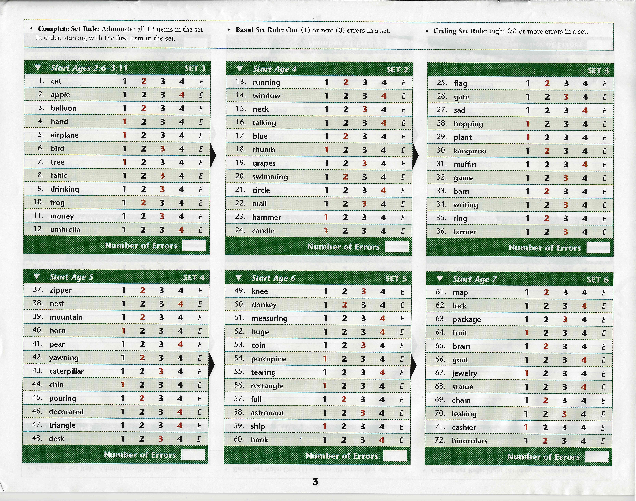
SETS FROM PPVT4
Notes:
Jimmy: The test is given verbally and takes from twenty to thirty minutes to complete. No reading is required by the individual, and scoring is rapid. For its administration, the examiner presents a series of pictures to each person. There are four pictures to a page, and each is numbered. The examiner speaks a word describing one of the pictures and asks the individual to point to or say the number of the picture that the word describes. Item responses can also be made by multiple choice selection depending on the age of the person being tested. The total score can be converted to a percentile rank, mental age, or a standard deviation IQ score. Although desirable, no special training is required to properly administer and score the PPVT-IV. The test publisher recommends that anyone interpreting or explaining the test scores should have knowledge in psychological testing and statistics.

Slide 10
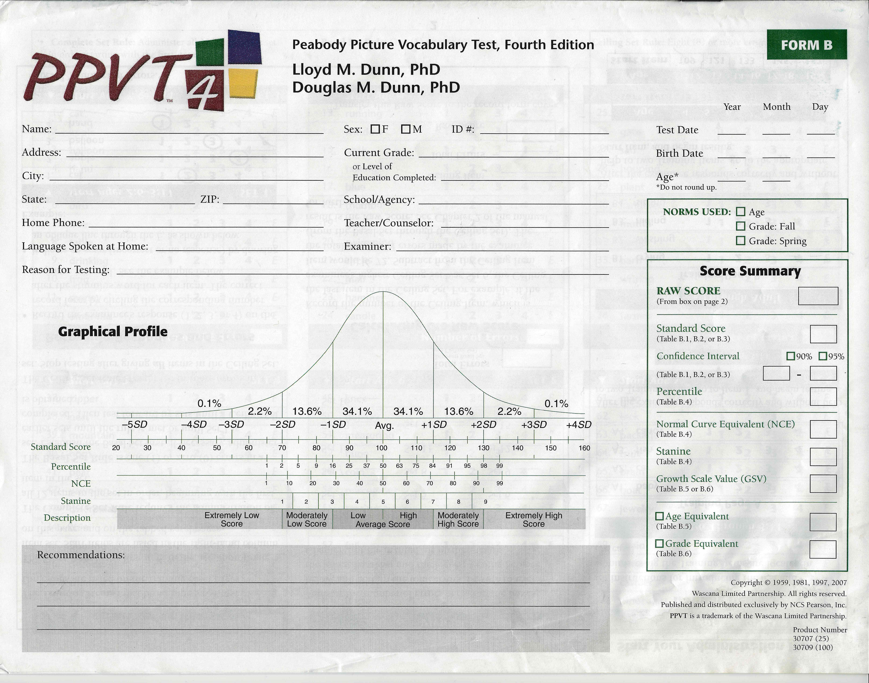
RESULTS PAGE
Notes:
Matt

Slide 11
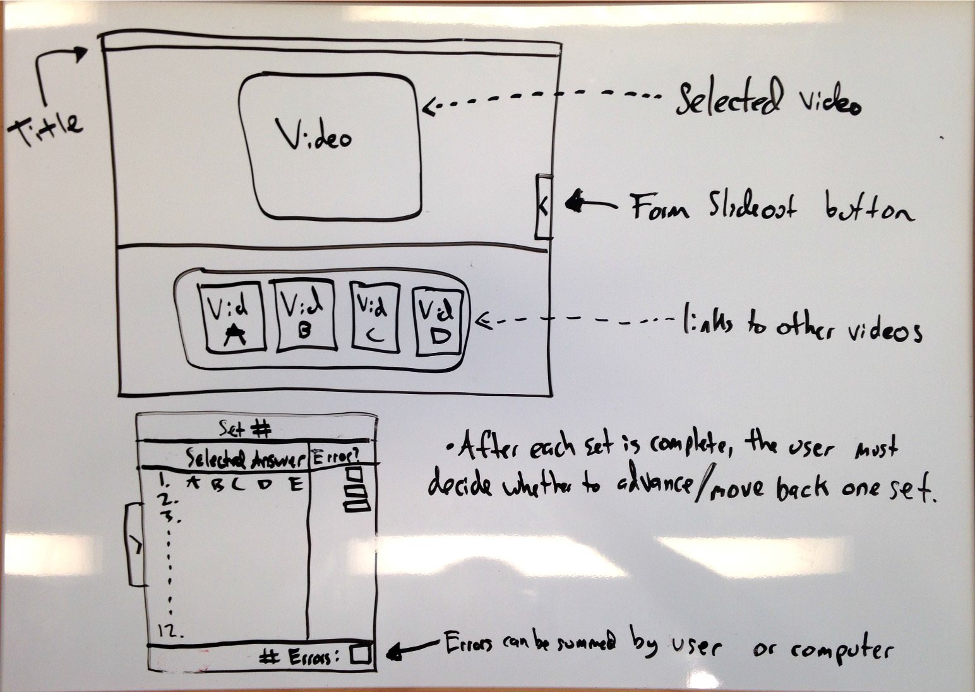
FRONT-END MOCKUP
Notes:
Matt

Slide 12
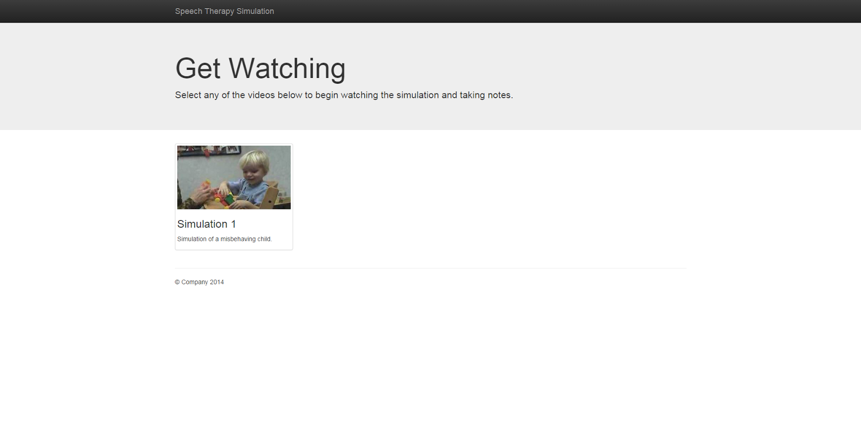
Notes:
Matt

Slide 13
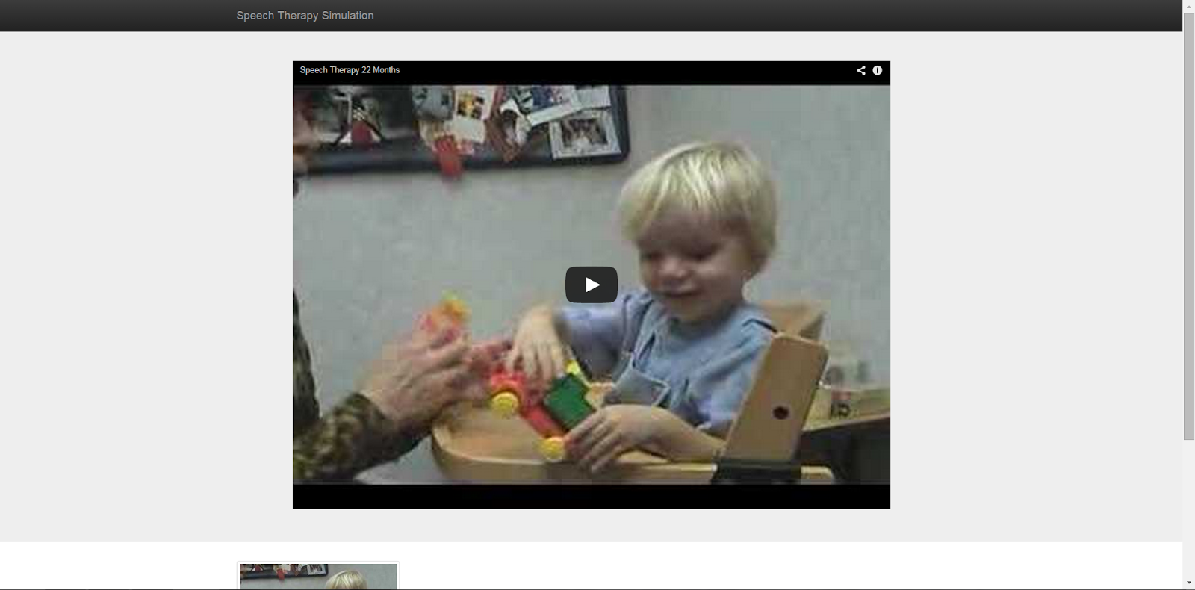
Notes:
Matt

Slide 14

Notes:
Matt

Slide 15
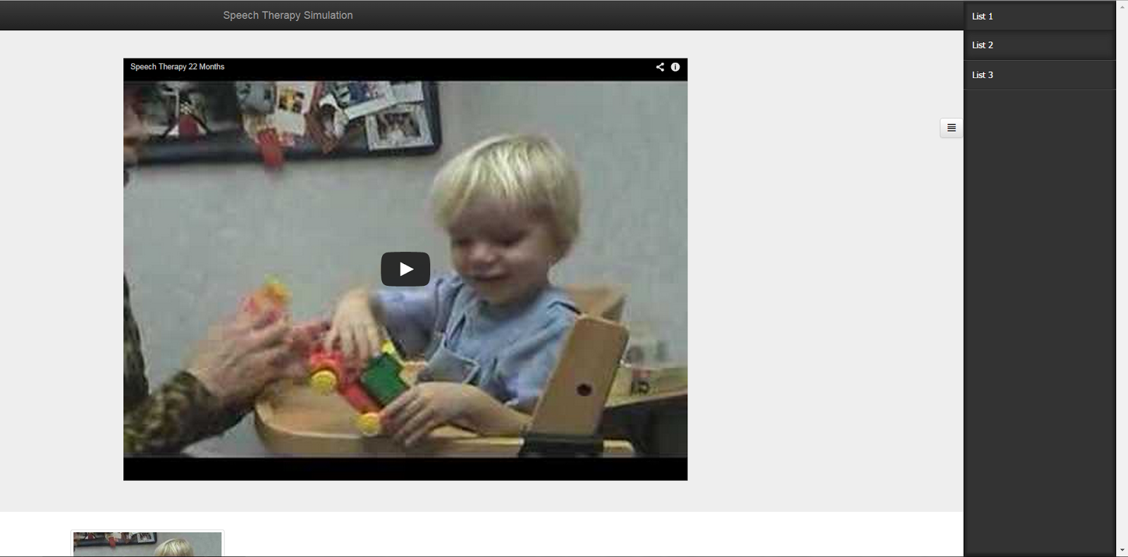
Notes:
Matt

Slide 16
TECHNOLOGY
JavaScript/HTML/CSS
HTML5 Boilerplate
Bootstrap
jQuery
Sidr
Notes:
Matt:
mention desktop only functionality: need for larger screen, having form overlay/obscure video does not accurately simulate the testing environment

Slide 17
SEMESTER GOALS
Fully implement the multiple choice and summary sections of the form
Implement timestamp/set progression functionality with YouTube player
Incorporate an examination video from the partner
Notes:
Ze

Slide 18
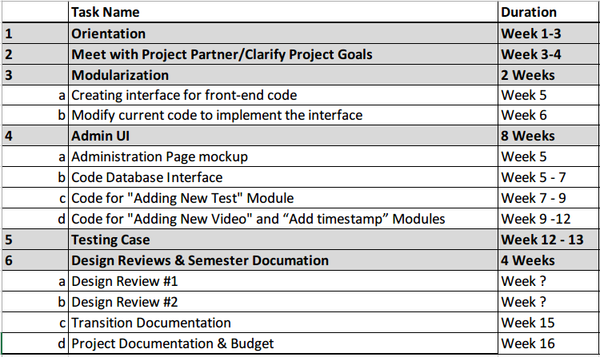
NEXT SEMESTER GOALS
Notes:
Ze
Modularize videos, test forms, and timestamps
Develop an admin module
Estimated delivery date: end of spring semster

Slide 19
Thank You!
Any Questions?

Slide 20
EPICS-SLAC
Henry Heim
Zhaowei Liang
Deep Randhawa

Slide 21


EPICS Explorer
Project Partner
Roberta Williams

Slide 22
GOAL
To provide a visual simulation for audiology students to practice testing different types of hearing loss.

Slide 23
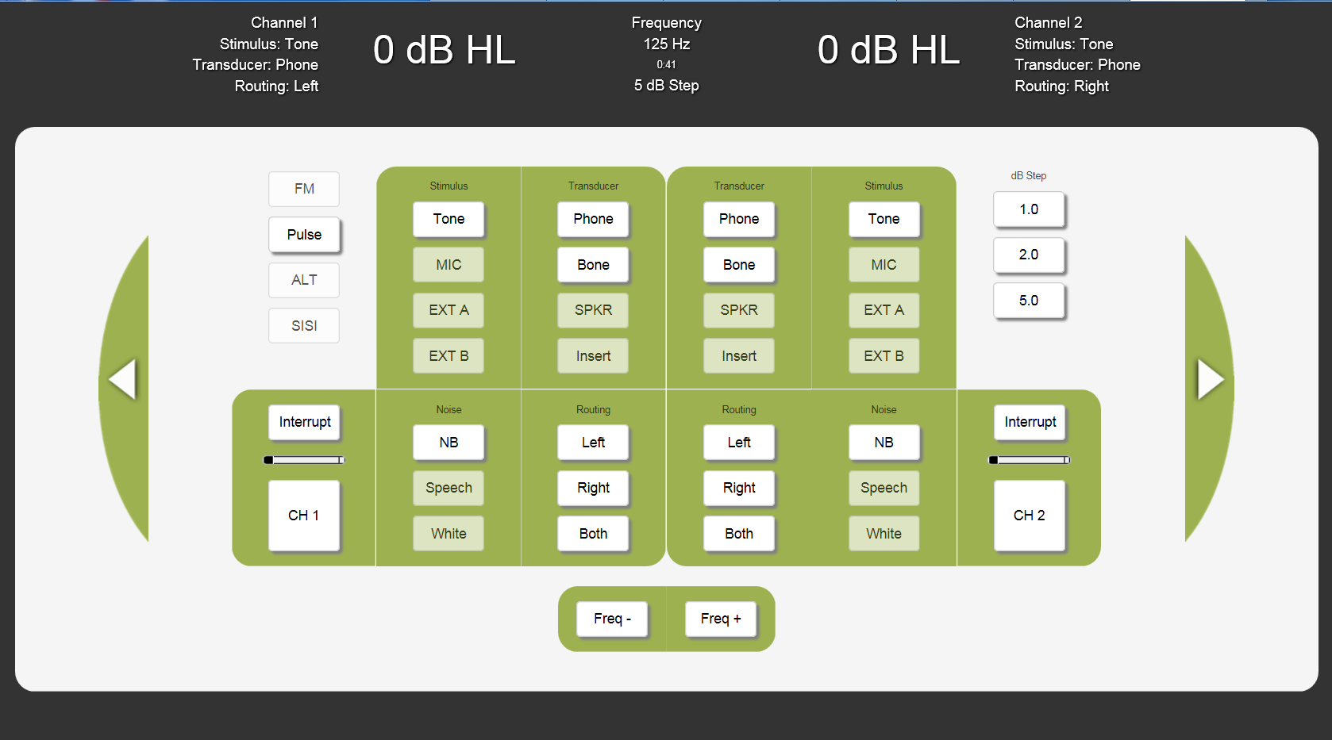
What we inherited

Slide 24
What we inherited
Unnecessary buttons
Small text in header
Channels are confusing
Not everything is functional

Slide 25
What we’re focusing on
Minor layout tweaks
Adding necessary functionality
Small user-friendly tweaks
Making code programmer-friendly

Slide 26
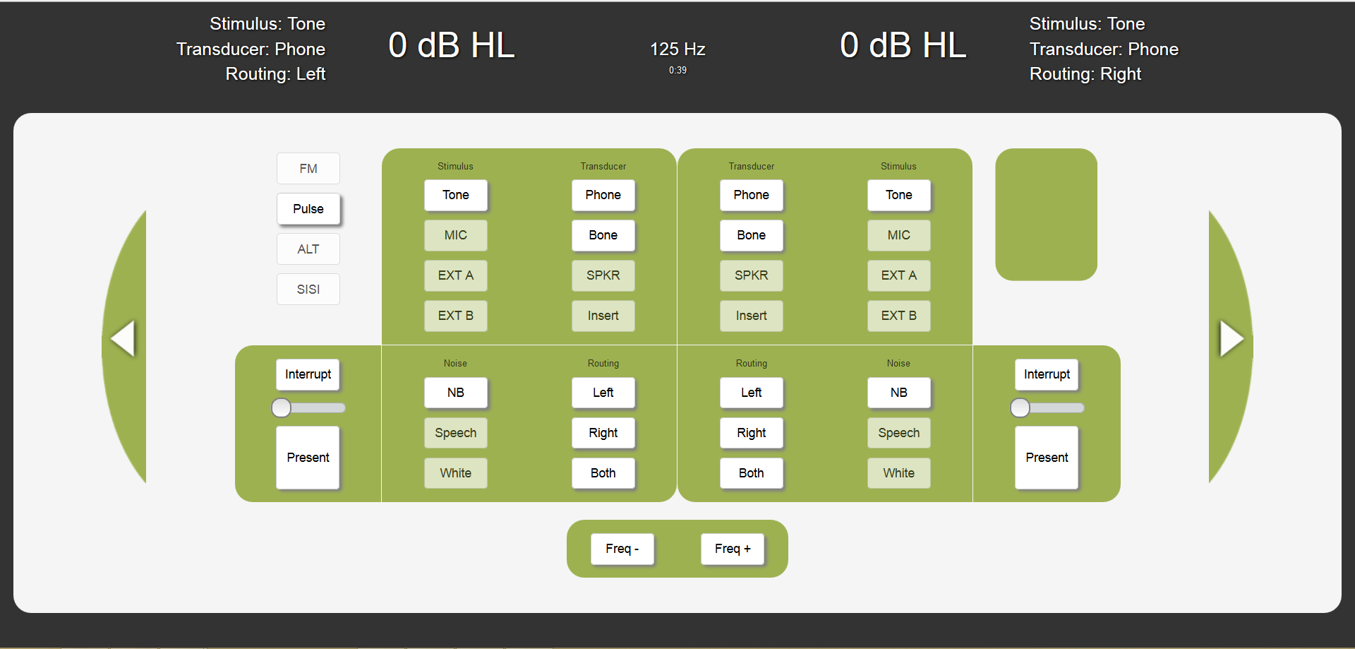
Layout changes
Removed unnecessary decibel buttons
Renamed channels
Increased header text size
Removed some header information

Slide 27
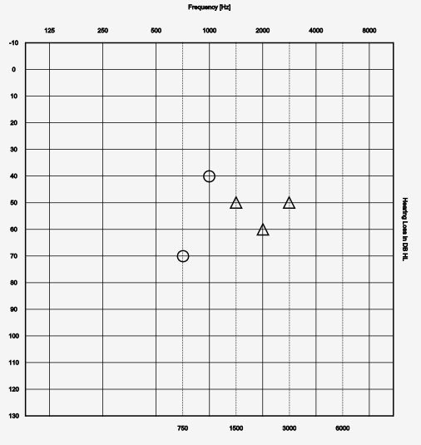
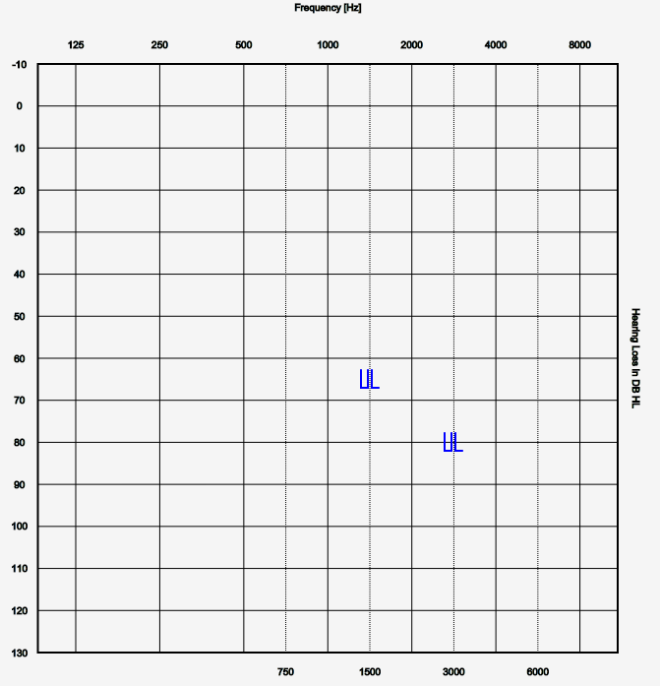
Remodel Audiogram
Original
Remodeled

Slide 28
Currently working on:
Audiogram symbol selection
Indicator light
Button highlights

Slide 29
Tech we’re using:
HTML5
Responsive HTML
Python
CSS
JavaScript

Slide 30
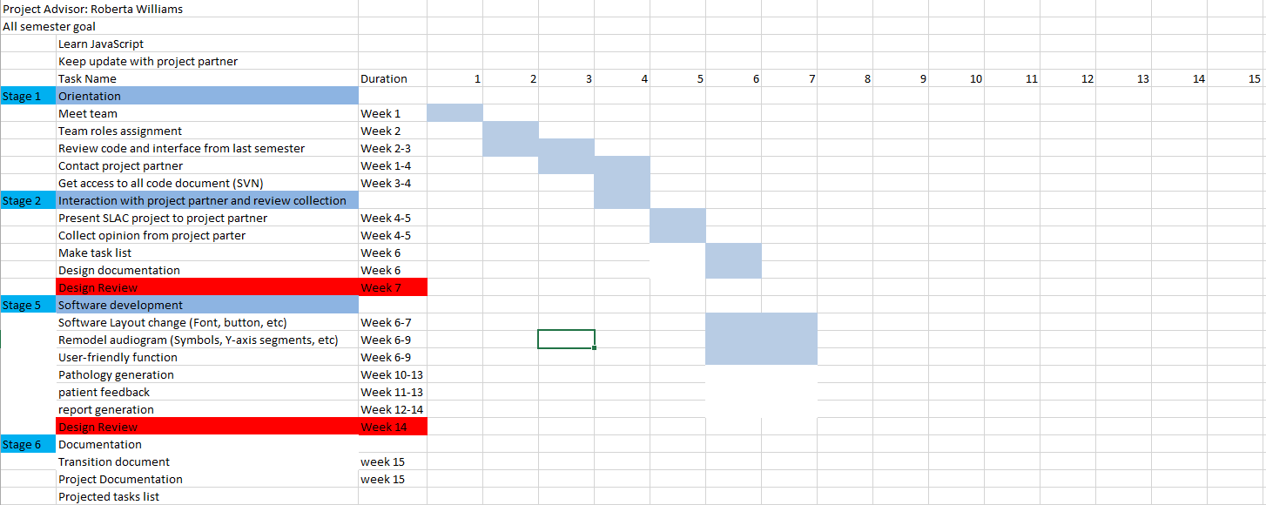
Semester Plan
Gantt Chart

Slide 31
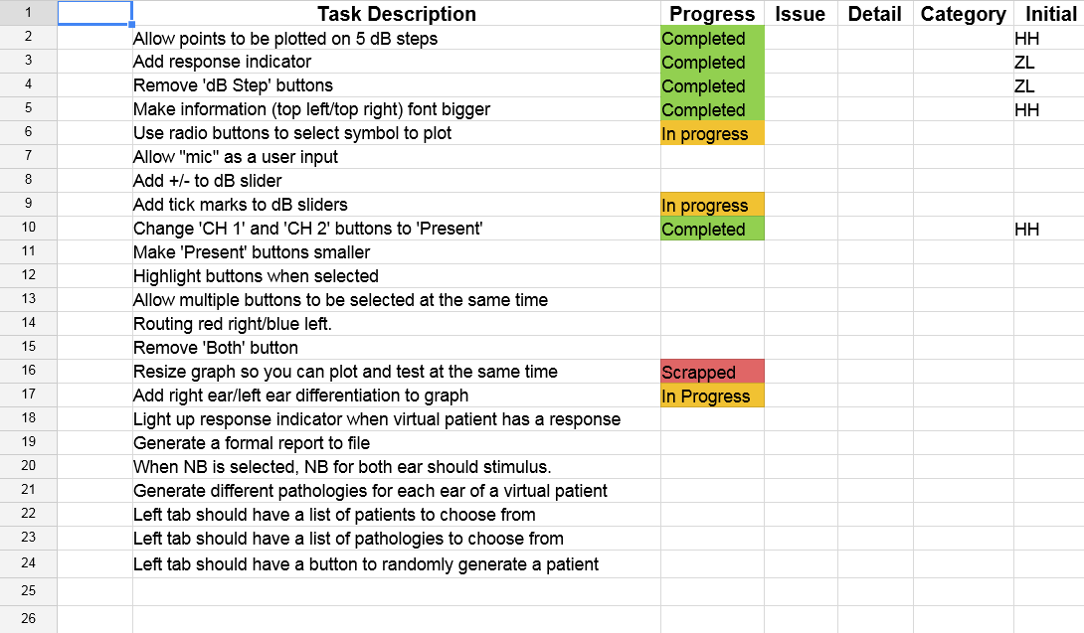
Task list

Slide 32
Future plans
Complete current tasks
Testing/Bugfixing
Virtual patient creation
Responsive design fixes

Slide 33
Questions and comments?

Slide 34
Dining Services Purdue Online Dining Guide (PODG)
Cameron Young
Gregory Macon
Jimmy Zhang

Slide 35
Project Partners
Dining Services, University Residences, Purdue University
Contacts:
Greg Minner
Director of Dining Services
gminner@purdue.edu
Kari Glebe
Director of Residential Dining
klglebe@purdue.edu

Slide 36
The Idea
Track the availability of spots inside the dining courts on Purdue’s campus and the length of the lines outside them at any given time.
Make it easy for the student community to figure out the fastest and most convenient place to eat
Give our project partners insight on how the dining courts are being used

Slide 37
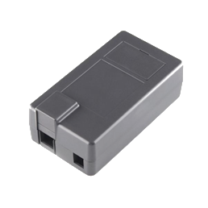
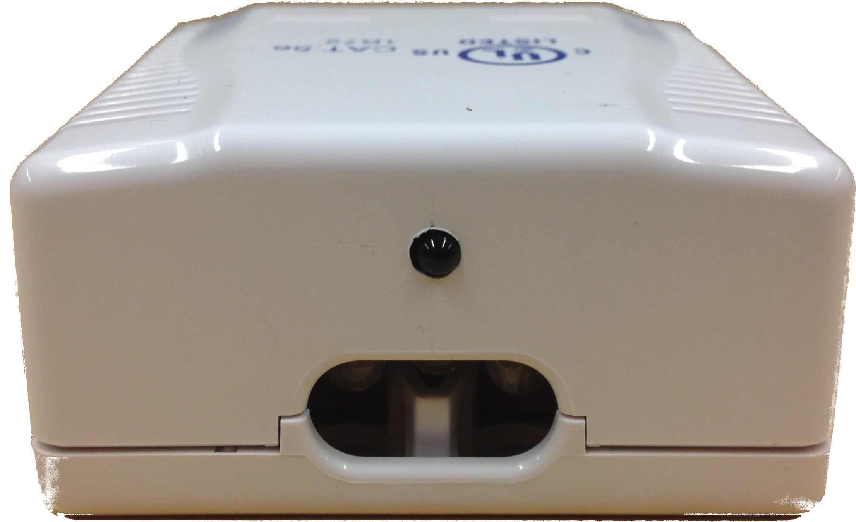
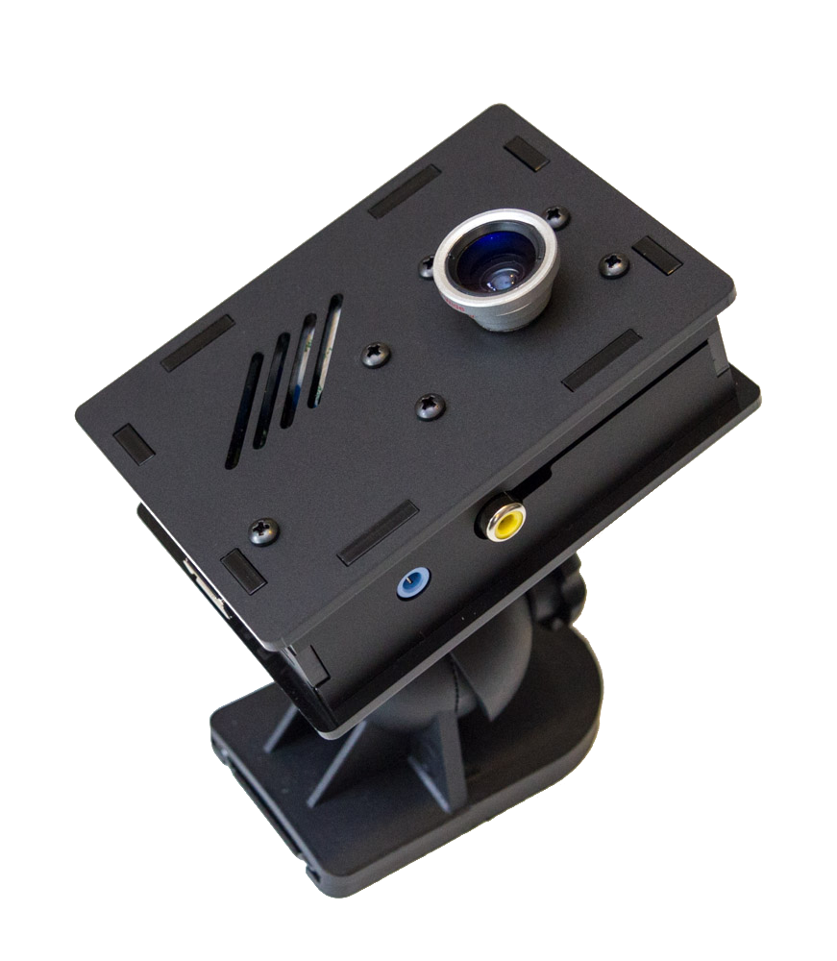
Previous Semesters
We had a functional system using infrared sensors
For higher accuracy we switched to cameras (2 have been built)

Slide 38
This Semester
New Director of Residential Dining
Blurred photo of the line
Installing the cameras (rescheduling)
Creating an API for Purdue’s app to use our data
Administrative page

Slide 39
Semester Timeline
 | Task Name | Duration | 1 | 2 | 3 | 4 | 5 | 6 | 7 | 8 | 9 | 10 | 11 | 12 | 13 | 14 | 15
Part 1 | Orientation | 4 Weeks
Part 2 | Installation | 2 Weeks
Part 3 | Coding Phase | 8 Weeks
Part 4 | Data Collection & Verification | 7 Weeks
Part 5 | Monitoring / Minor Tweaks | 3 Weeks
Part 6 | Design Reviews & Semester Documation | Week 7, 14 - 16

Slide 40
How it Works
Each dining court will have two cameras
Entrance and Exit
Track entry/exit using our camera system
Sends data to the MySQL database
Current Count
(Entrances counted) – (Exits counted)
Will be able to show a plot of count over current meal

Slide 41
System Details
Each box has a Raspberry Pi computer with a small camera and a Wi-Fi adapter
The only external wire is for power
The processing (counting) occurs on each Raspberry Pi and only the results are sent to the server

Slide 42
System Diagram
Dining Court
Raspberry Pi
Entrance Counter
Camera
Purdue iTaP Server
RESTful API (PHP)
API
Dining Services Website
Wi-Fi Adapter
Raspberry Pi
API
Exit Counter
Dining Services Mobile App
Camera
MySQL Database
Wi-Fi Adapter

Slide 43
Trial Deployment Location: Earhart
Exit
6’
Entrance
11’
5’6”
2’
5’6”
5’
4’5”
2’
Power Outlet
Card Swiper
12’6”

Slide 44
Progress
This Semester
Have cameras updating their information in the database
Installation being rescheduled
Setup an administration page to display the IP addresses of the cameras

Slide 45
Problems we faced
Installation
Minimal number of wires
Had to wait for two outlets to be added in Earhart
Counting
People pacing back and forth by the exit may be counted repeatedly
Coding
The tests we have done have been in the EPICS lab and not Earhart
No storing images
No face recognition (only detection is allowed)

Slide 46
Budget
Camera System – roughly $250 per dining court (includes 2 cameras)
Each box needs:
Raspberry Pi Model B - $40
4GB SD Card - $8
Raspberry Pi Camera - $30
Raspberry Pi Camera Box w/ Wall Mount - $22
Mini USB Wi-Fi - $12
Power Adapter - $7

Slide 47
API
Will provide:
The number of people currently inside each dining court
(Possibly) a blurred image of the line
An estimate of the current wait time

Slide 48
Administration Page
Allows for updates to the dining court structure by dining services after project delivery
Includes adding new dining courts, changing hours, etc.

Slide 49
Remaining this Semester
Collect data from Earhart and tweak the software for better results
OpenCV has lots of parameters that can be tweaked
Complete the API for accessing the data
Update the Administration page to demo the API

Slide 50
Next Semester
TBD

Slide 51
Thank You
Questions?
Comments?

Slide 52
EPICS Explorer
Yoselyn Walsh
Naveen Ganessin
Zach Simpson
Logan Fuller

Slide 53
EPICS Explorer
Project Partner
Pam Brown EPICS Program Coordinator
Goal
To provide a portal for incoming EPICS students to choose the EPICS team that is best suited for their major/interest.

Slide 54
Project Specification Development
Previous Website
Design is old, too much text
Major specific, not very detailed
Hundreds of HTML files
Proposed Website
Better UI, redesign of the old website
Minimize HTML file
Creation of an Admin module for simple updating.
Considerations
Visually appealing to incoming student
Easy to use (incoming students)
Easy to update (project partner)
Reports data most efficiently

Slide 55
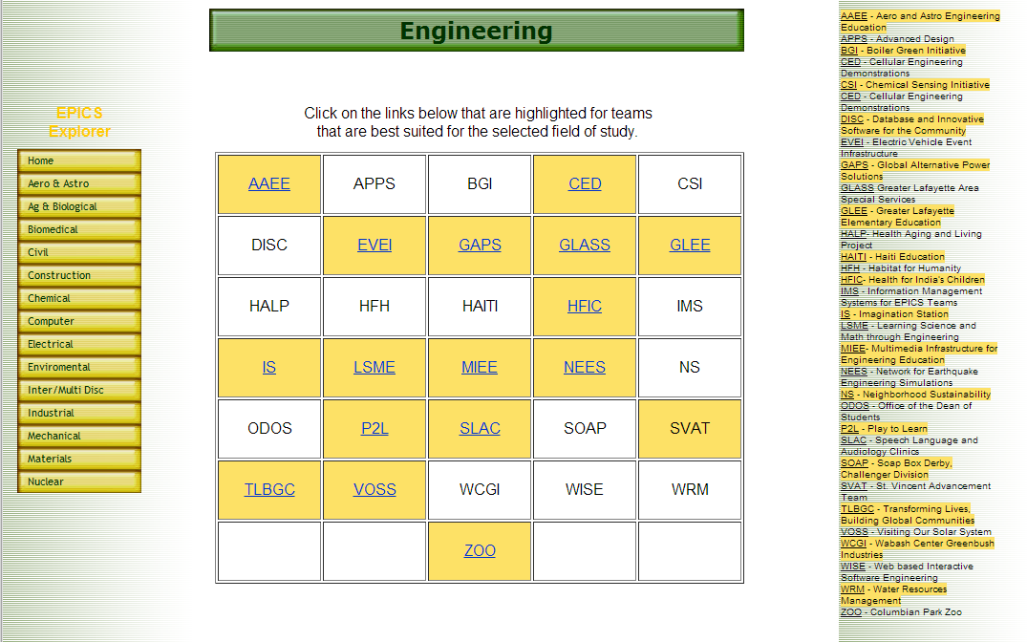
Previous Website

Slide 56
Previous Semester
Progress made
Researched about the background of each team.
Initial web page design done.
Initial database design completed
Challenges
Research data did not include many of the Epics teams
Web page design conflicts with information received from Project Partner.
Database design included detailed search criteria but would be tedious to update
No returning members of project for current semester

Slide 57
Current Semester
Progress made
Researched about the background of each team.
Got a clear overview of the goals of the project from our project partner.
Initial Admin module design done.
Initial database design completed.
Challenges
Need to analyze the research data.
Re-evaluate design of database and user interaction
Misunderstood the intended method of searching for a team

Slide 58
Database Design
Database link

Slide 59
Proposed Design
Design link

Slide 60
Technical Implementation
Apache web-server with PHP for server backend
Open source and easy to maintain
JavaScript and Ajax/JQuery for dynamic scripting
Twitter Bootstrap
Popular HTML framework for front-end design
Wide variety of premade CSS classes

Slide 61
Semester Plan

Slide 62
The Next Step…
Determine any changes the Project Partner would like with the mock up
Update the database and mockup
Begin coding the Admin module

Slide 63
Thank You! Questions and Comments?

